Slide 1
Numerical Methods
Adrita Alam
Lecturer
Dept. of CSE
Varendra University, Rajshahi
adritaalam.prima@gmail.com

Slide 2
Outline
Introduction
Approximations and Errors
Roots of Equations
Systems of linear algebraic equations
Curve Fitting
Numerical Differentiation and Integration

Slide 3
Introduction

Slide 4
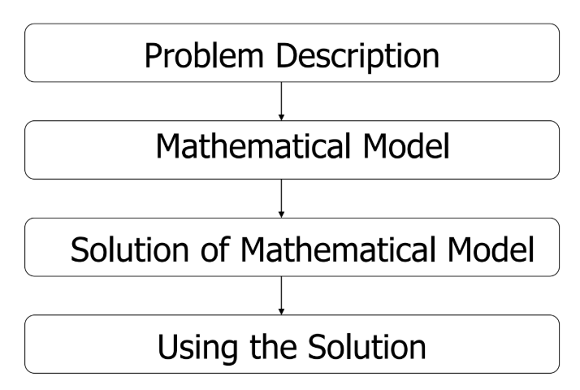
How do we solve an engineering problem?

Slide 5
What are Numerical Methods?
Numerical methods are techniques used to approximate solutions to mathematical problems.
They are essential for solving equations that cannot be solved analytically.
Numerical methods involve large numbers of tedious arithmetic calculations.
Widely used in engineering, physics, and data science.

Slide 6


Reasons to study numerical analysis
Powerful problem solving techniques and can be used to handle large systems of equations.
Analytical methods can be impractical or time-consuming.
It enables you to intelligently use the commercial software packages as well as designing your own algorithm.
Numerical Methods are efficient vehicles in learning to use computers
It reinforce your understanding of mathematics; where it reduces higher mathematics to basic arithmetic operation.
Large systems of equations
Non-linearity
Complicated geometries that are common in engineering practice and that are often impossible to solve analytically.
Examples:

Slide 7
Analytical Methods vs. Numerical Methods
Feature | Analytical Methods | Numerical Methods
Nature | Exact solutions | Approximate solutions
Applicability | Works for simple equations | Handles complex equations
Computational Effort | Requires algebraic manipulation | Requires iterative computation
Error | No approximation error (if solvable) | Introduces rounding and truncation errors
Examples | Quadratic formula, integration formulas, symbolic differentiation | Newton-Raphson, Euler’s Method, Trapezoidal Rule

Slide 8
Advantages & Limitations
Advantages:
Can handle complex problems.
Provides approximate solutions quickly.
Can be implemented in programming languages like Python, Matlab, R
Disadvantages:
Approximate solutions, not exact.
Computation cost and numerical errors.

Slide 9
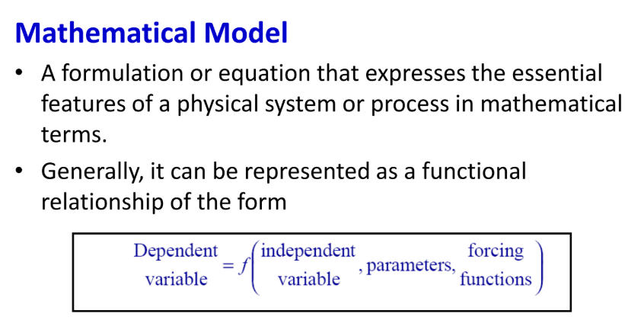
Simple Mathematical Model

Slide 10
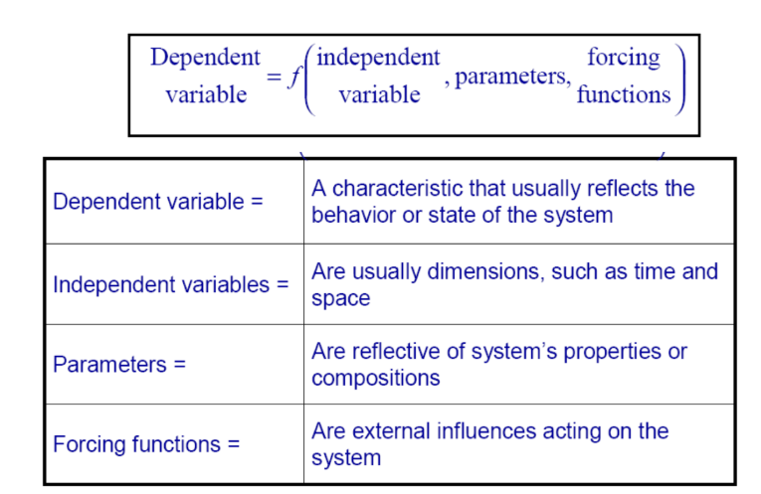
Mathematical Modeling

Slide 11
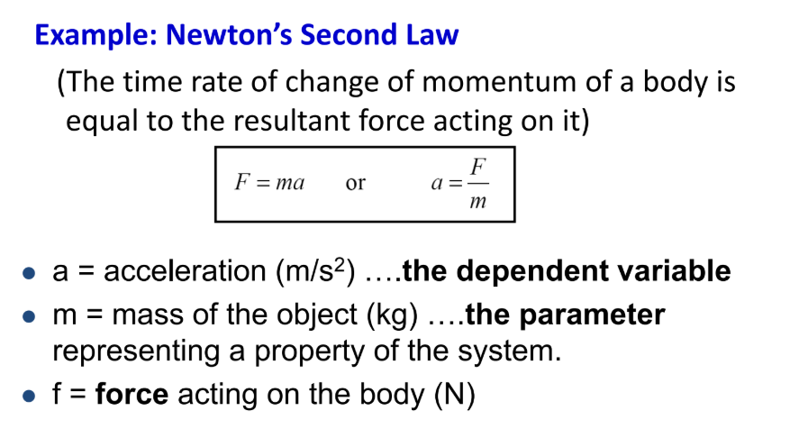
Simple Mathematical Model

Slide 12
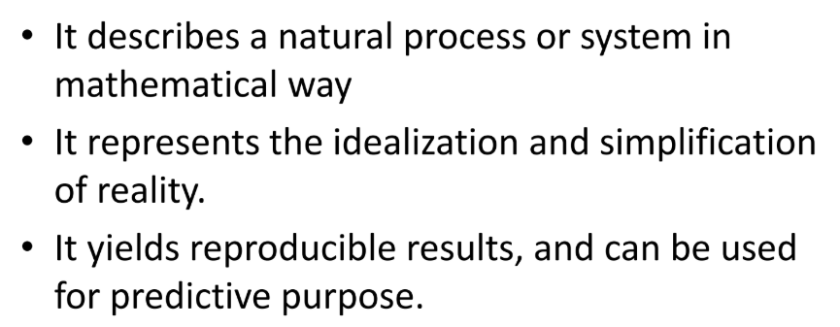
Typical characteristics of Mathematical Model

Slide 13
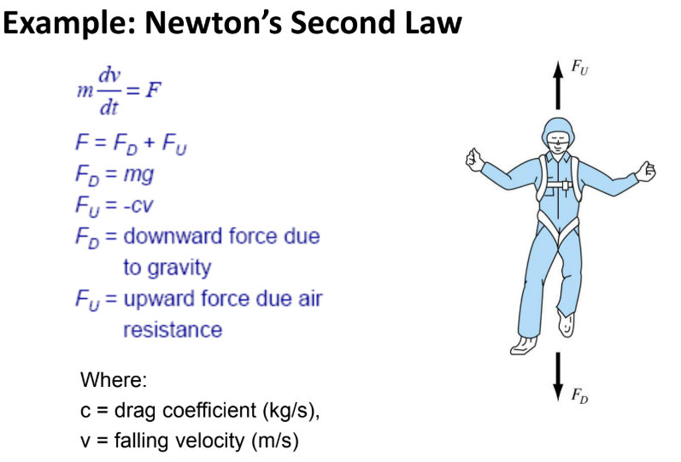
Complex Mathematical Model

Slide 14
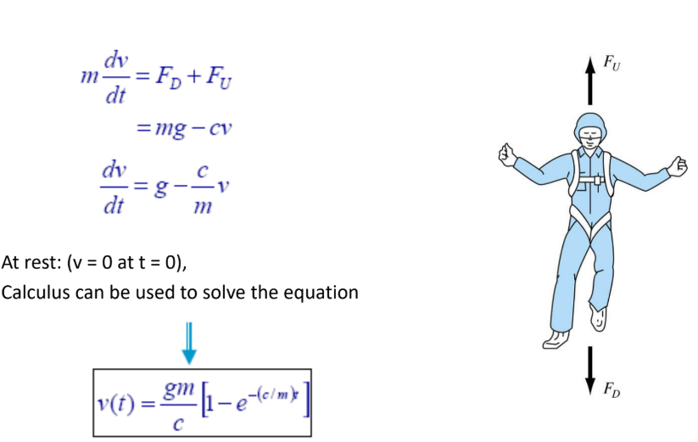
Complex Mathematical Model

Slide 15
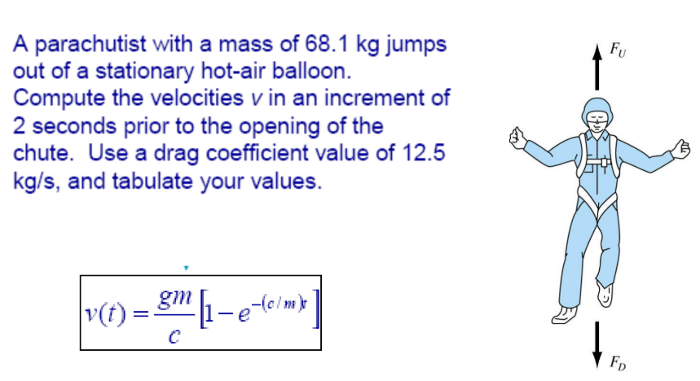
Analytical Solution to Newton’s Second Law

Slide 16
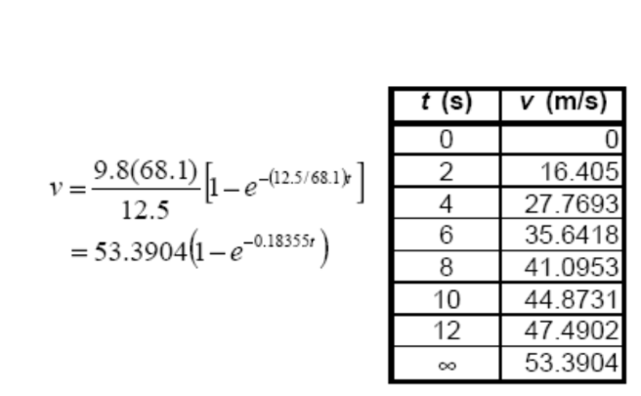
Analytical Solution to Newton’s Second Law

Slide 17
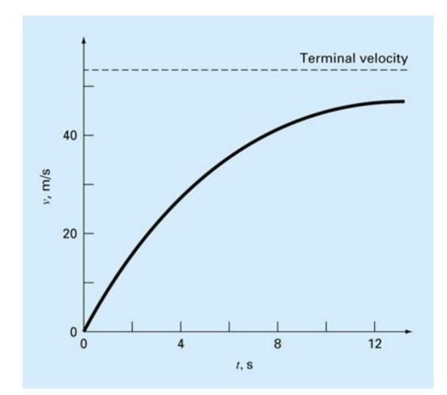
Analytical Solution to Newton’s Second Law

Slide 18
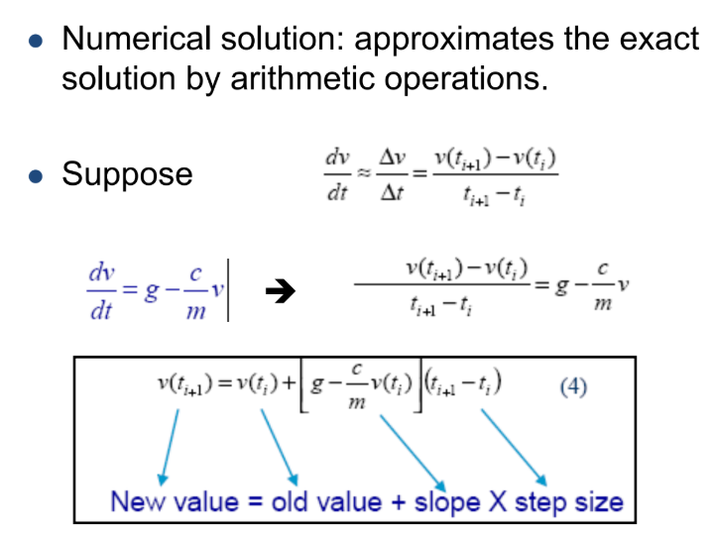
Numerical Solution to Newton’s Second Law

Slide 19
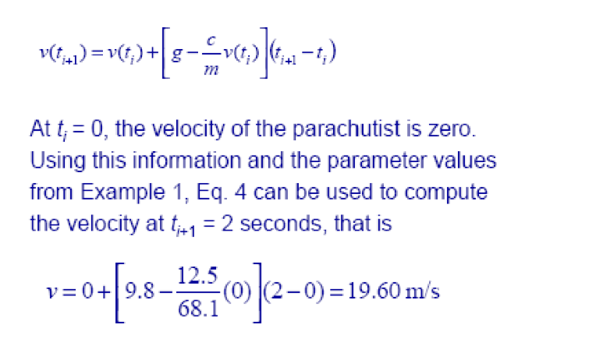
Numerical Solution to Newton’s Second Law

Slide 20
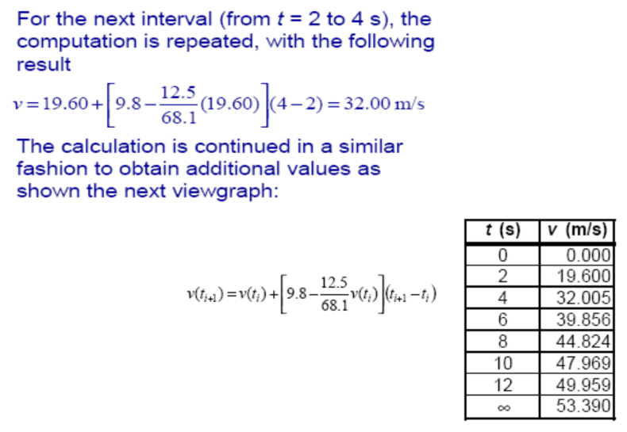
Numerical Solution to Newton’s Second Law

Slide 21
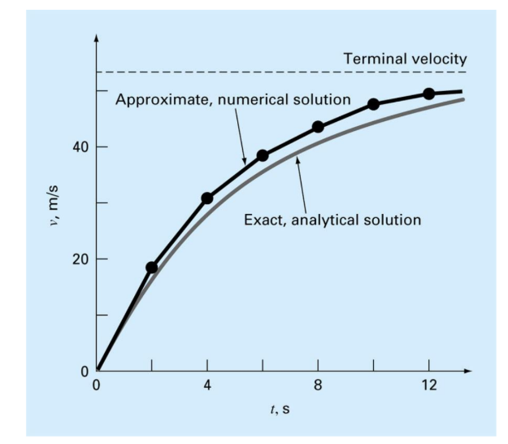
Comparison between Analytical vs. Numerical Solution

